Slide 1
Final Project
Hunter Bruso

Slide 2
Project idea
List of MTG Commanders ranked based of play time and win rates, and looked at the dates they were created and compare them to opposing ranks based off there overall combined playtime and win rates, to see if older cards stand up to newer ones
Found the list off a website used to track the popularity of cards, here is that website https://tappedout.net/mtg-decks/list-multiplayer-edh-generals-by-tier/

Slide 3
Before we begin
Research question: are the older cards as good as the newer ones, interested in the game, like game design, wanted to look into the data for a long time
Important things to remember: magic was initially released in 1993, 28 years ago, that number doesn't come up, neither does most dates close to it
How I organized my data: Used different ranks to separate my data values then separated them into graphs based on the rank and year they were made

Slide 4
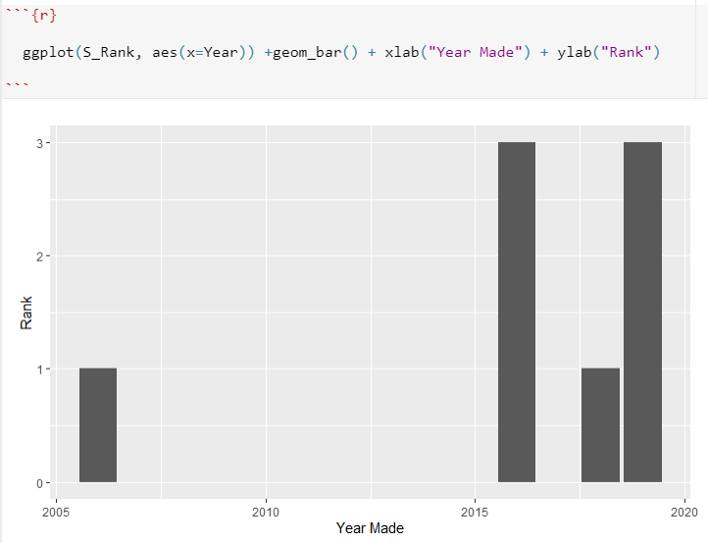
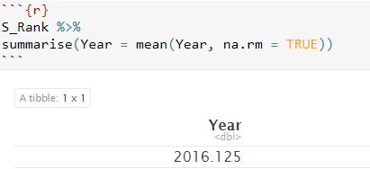
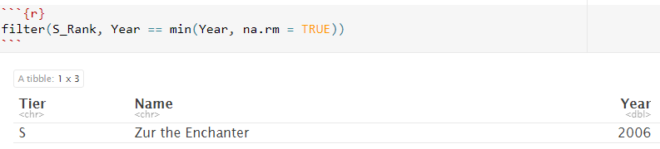
S_Rank
Not a lot of data
Most cards in 2016 and 2019
Only Rank with no 2020 cards

Slide 5
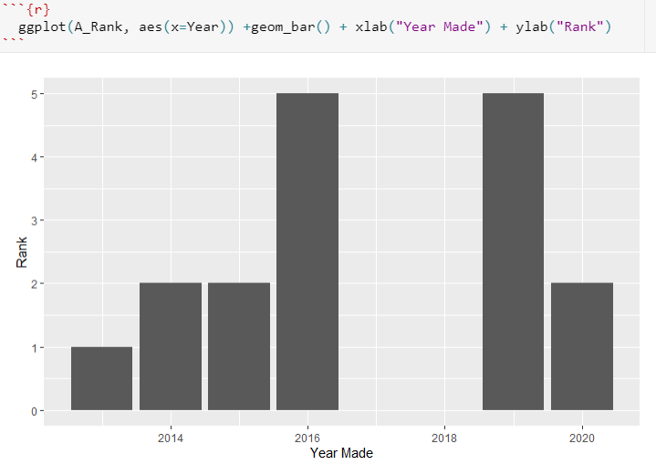
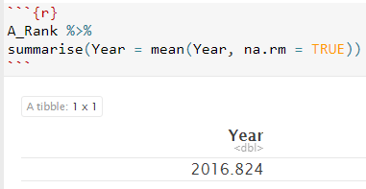
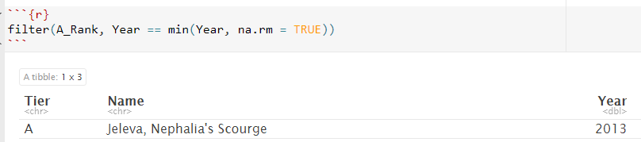
A_Rank
Gap between 2017 and 2018

Slide 6
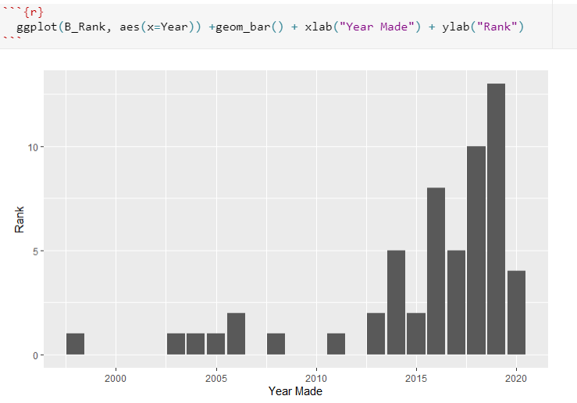
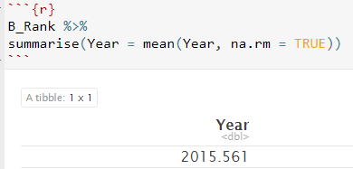
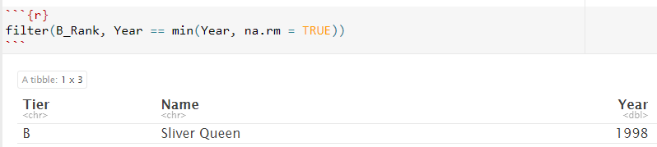
B_Rank
A lot more diverse values
1st card made before 2000
Majority 2015 and beyond

Slide 7
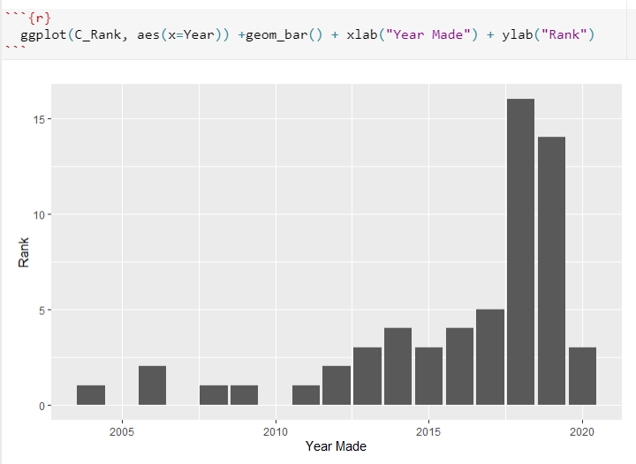
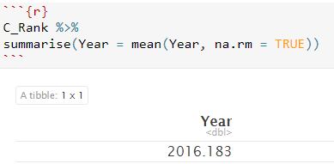
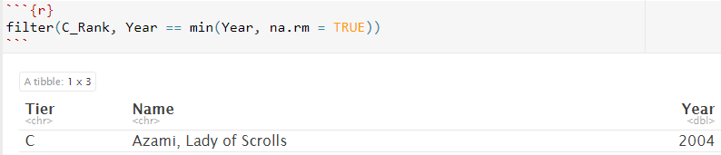
C_Rank
Lowest is above 2000
most values in 2018

Slide 8
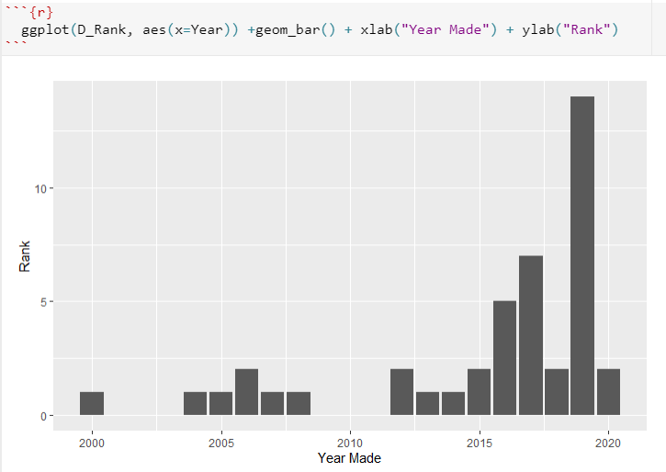
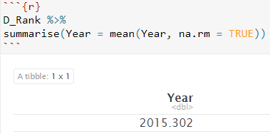
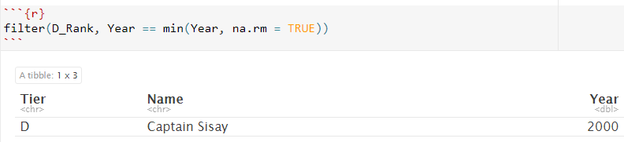
D_Rank
Back down to 2000
Majority again in 2019

Slide 9
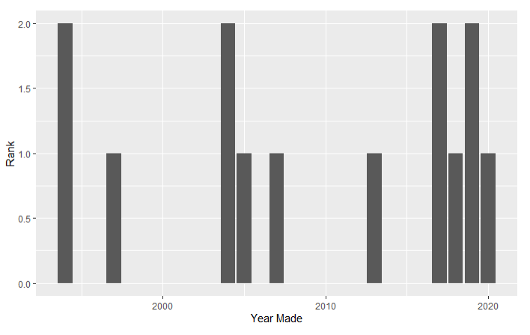
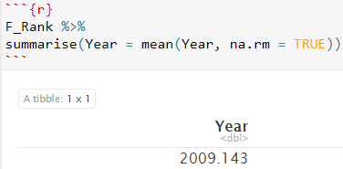
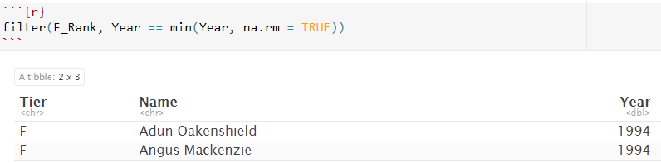
F_Rank
A lot of values
Lowest min values
Most amount of values

Slide 10
Conclusion
What I learned in about my data:
Average mean was 2016 meaning this was the most popular year
Most values were in 2015 and above
Lowest value was 1994 1 year after the release of magic the gathering, found in F_Rank
Most of the cards that are considered the best were made in 2016 or 2019 so therefore the best to buy if you want better cards
The most diverse data was found in F_Rank
Do older cards stand up to newer ones: no
What skills I used in R: creating bar graphs, separating data R from a graph into separate exponents, finding the max, min, and mean in r studio

